Slide 1
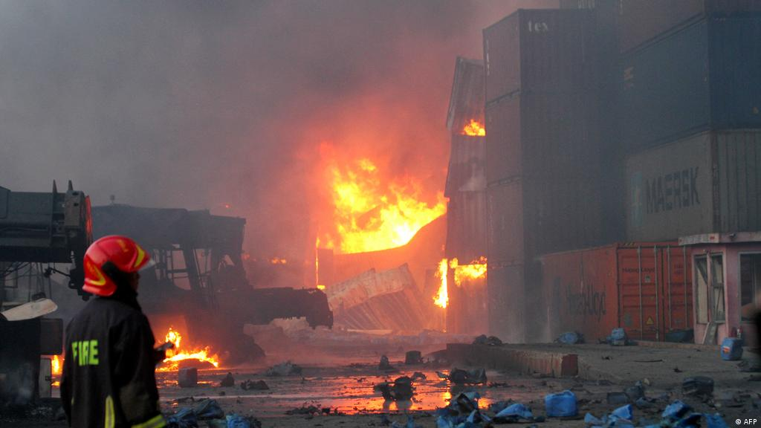
Design a fire detection and Protection system for a single storied 850 sq ft restaurent. EEE-300: Electrical Service Design Section-01

Slide 2

Group-05
Name | Student ID
Rakibul Islam Rifat | 2020-1-80-001
Shahjia Anjum | 2020-1-80-063
Bipu Roy | 2020-1-80-067
Abdullah Al Rafi | 2020-1-80-068
Ibn Zoha Sayad | 2020-1-80-075

Slide 3
Objective
We are to design a fire detection system that protects an 850 sq feet restaurant from fire hazards.

Slide 4
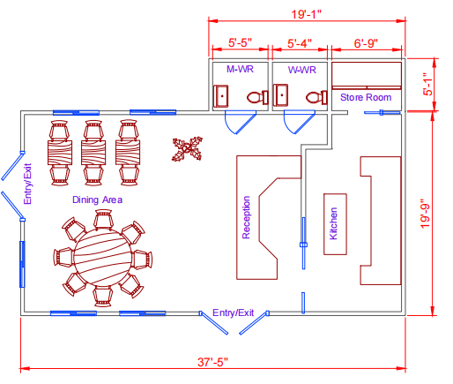
Floor Plan

Slide 5
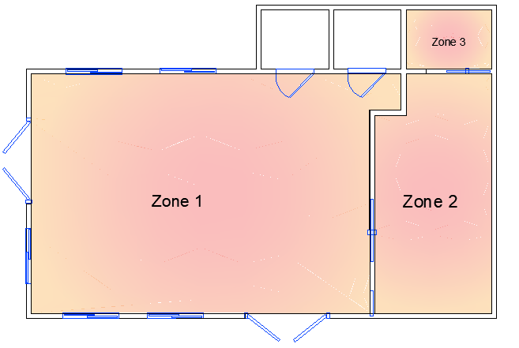
Fire protection zones

Slide 6
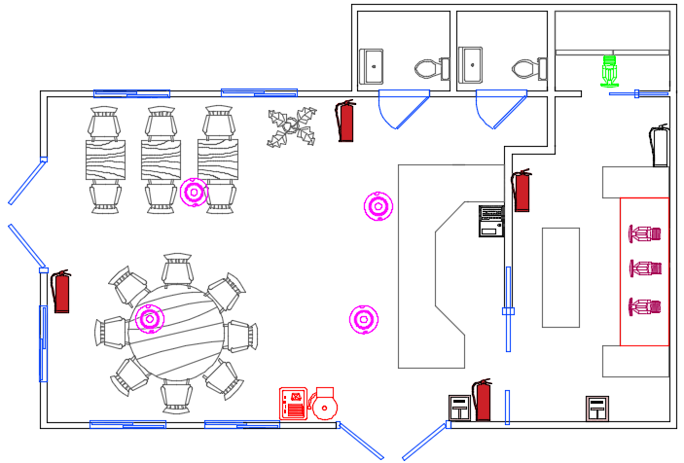
Fire detection and protection system

Slide 7
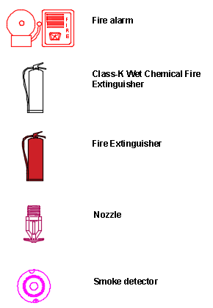
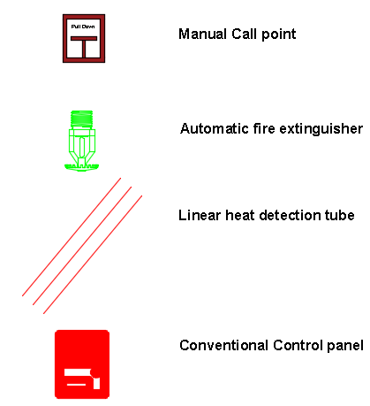
Legends

Slide 8
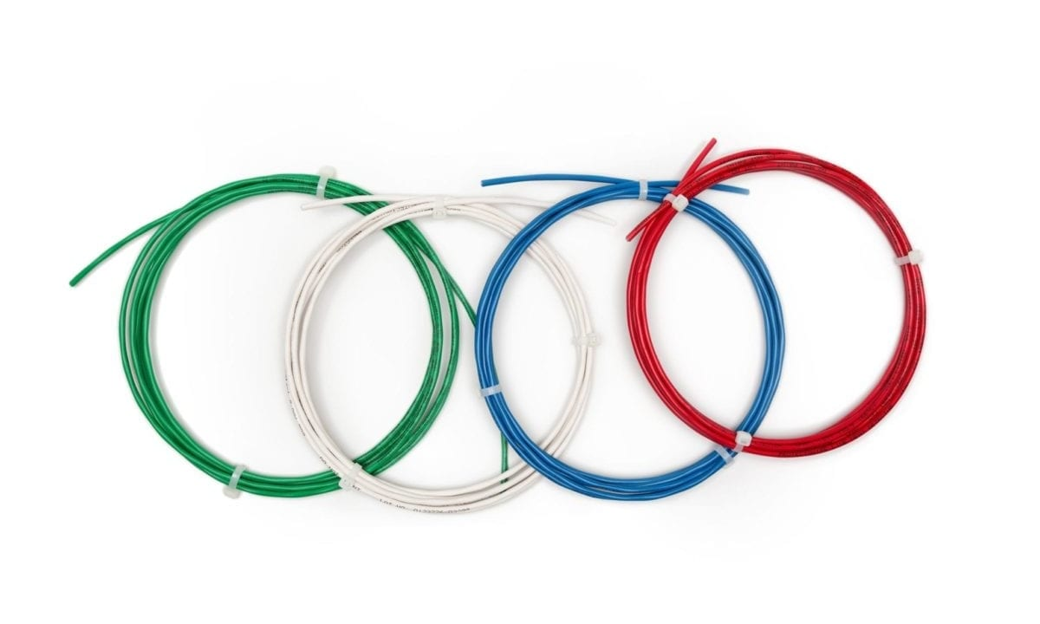
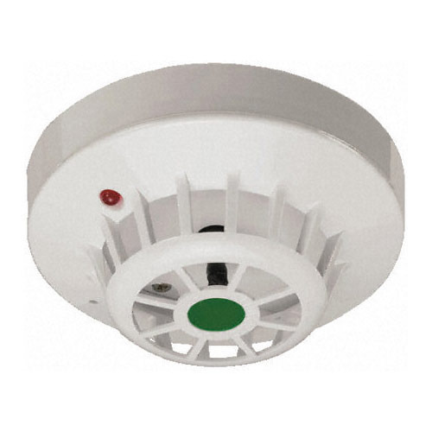
Various types of detection devices
Linear heat detection wire
Heat detector

Slide 9
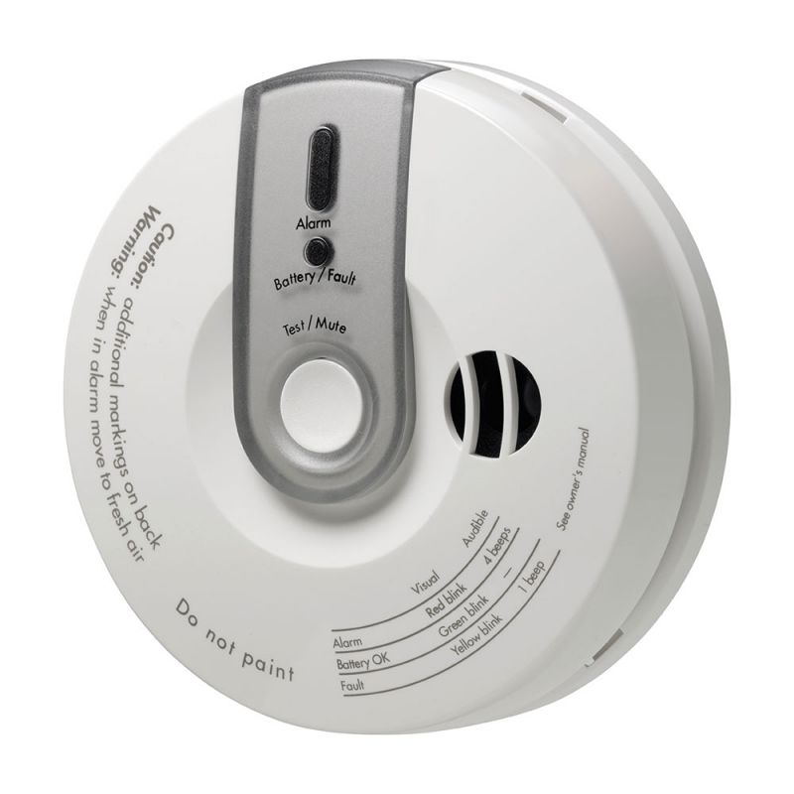
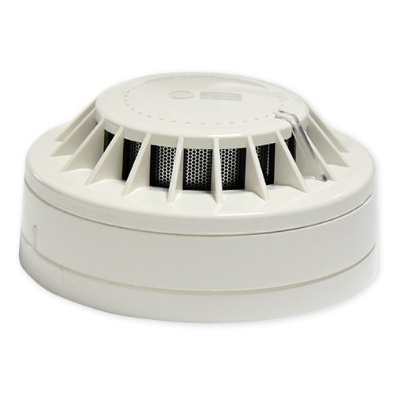
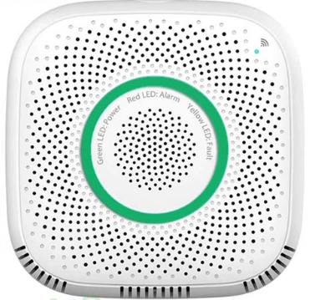
Various types of detection devices
Carbon monoxide detector
Smoke detector
Gas leakage detector

Slide 10
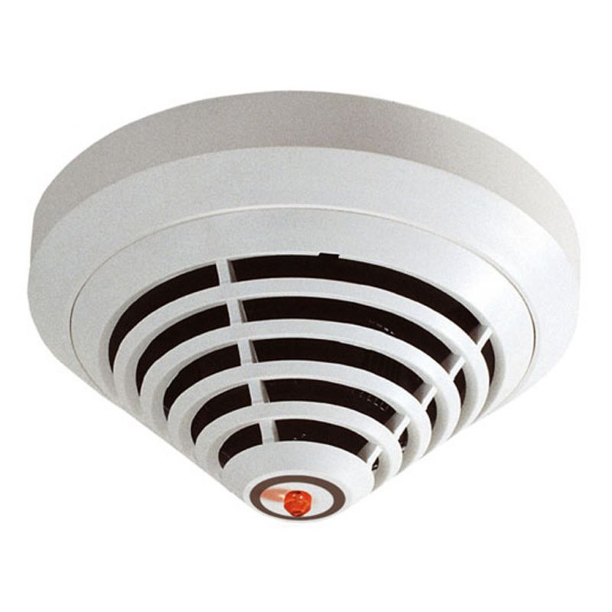
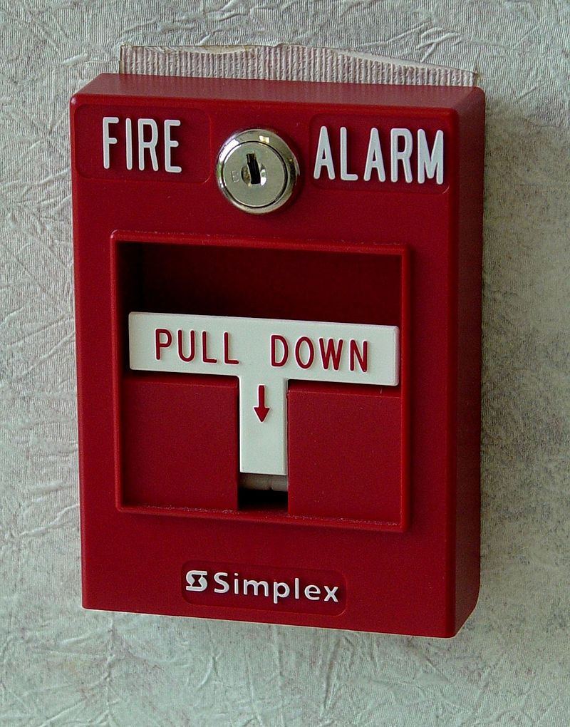
Various types of detection devices
Multi sensor detector
Manual call

Slide 11

Chosen smoke detector
Device specification:
Type: Photoelectric
Price: 1,140 BDT
Working current: <= 100mA
Alarm sound pressure: 85dB/1m
Detection range: 215 sq feet
Installation method: Ceiling installation
Working temperature: -10°C to +50°C
Link: https://www.aliexpress.com/item/1005004149450576.html?spm=a2g0o.productlist.0.0.1e7f1b1fBGLajt&algo_pvid=7c4a48c3-6743-4e59-bf64-dffeea109311&algo_exp_id=7c4a48c3-6743-4e59-bf64-dffeea109311-1&pdp_ext_f=%7B"sku_id"%3A"12000028199646090"%7D&pdp_npi=2%40dis%21BDT%212281.15%211140.58%21%21%21628.27%21%21%402101d68d16623632965632967e990a%2112000028199646090%21sea&curPageLogUid=sMqtIuvxdvXr

Slide 12
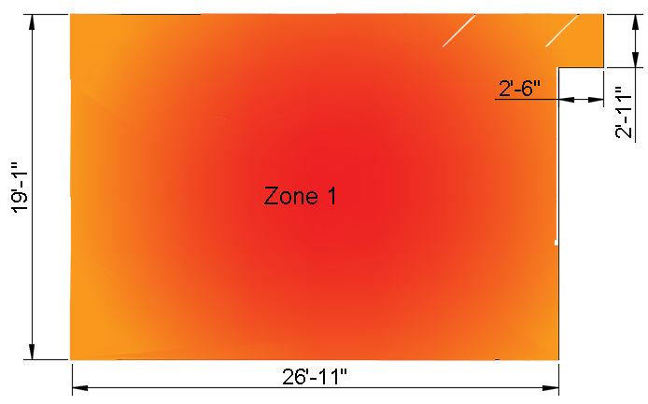
Calculation for smoke detector
Total area of zone-1 is 520

Slide 13
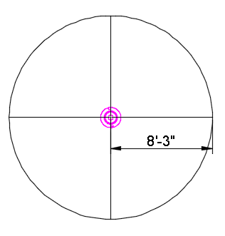
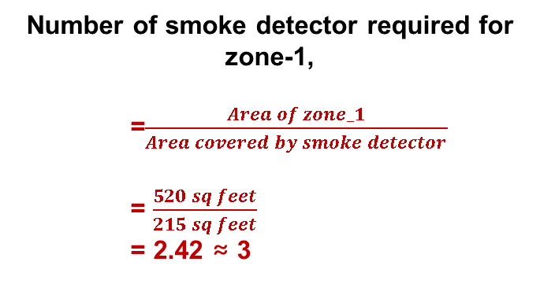
Calculation for smoke detector
Number of smoke detector required for zone-1,
=$\frac{Area of zone_1}{Area covered by smoke detector}$ = $\frac{520 sq feet}{215 sq feet}$ = 2.42 ≈ 3
Area = 215 sq feet

Slide 14
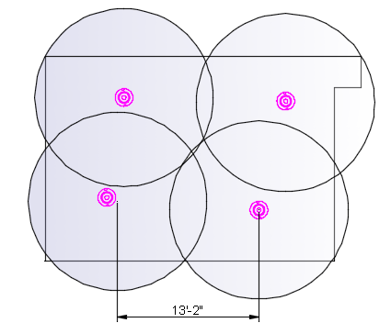
Calculation for smoke detector
Maximum distance between smoke detectors is 30 feet
Smoke detectors should be 3 feet away from windows and doors
[According to NFPA]
No Blank spot!

Slide 15
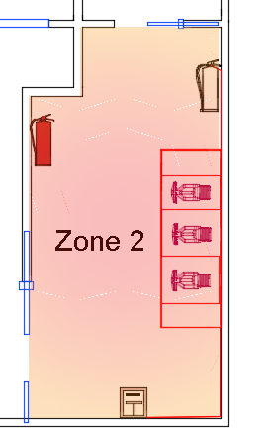
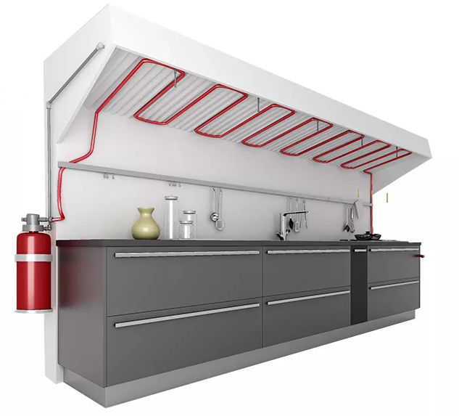
Fire suppression system:

Slide 16
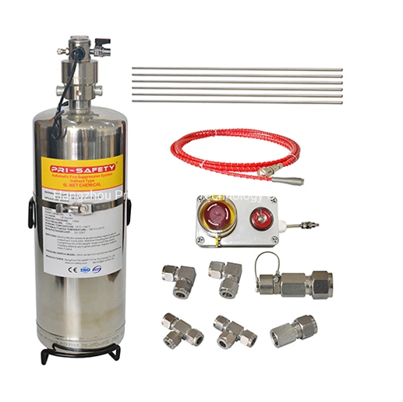
Protection equipment's for suppression system:
Class-K wet chemical extinguisher
Linear heat detection pipe
Nozzles
Manual call point

Slide 17
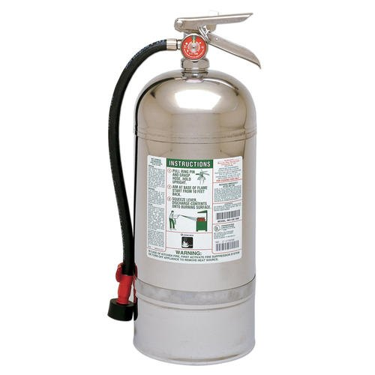
Protection equipment's for suppression system:
Device specification:
Brand: Safety plus
Price: 12,504 BDT
Capacity: 6L
Discharge range: 90%
Discharge time: 15-20 sec
Link: https://www.indiamart.com/proddetail/6l-class-k-type-fire-extinguisher-20029719730.html

Slide 18
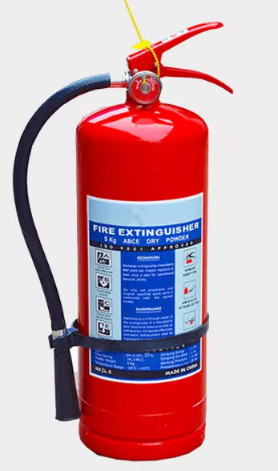
Selection of fire extinguisher
Device specification:
Brand: Sunrise
Price: 2,700 BDT
Capacity: 5L ABC powder
Suitable fire type: All
Link: https://fireextinguisher.me/product/abc-dry-powder-fire-extinguisher/

Slide 19
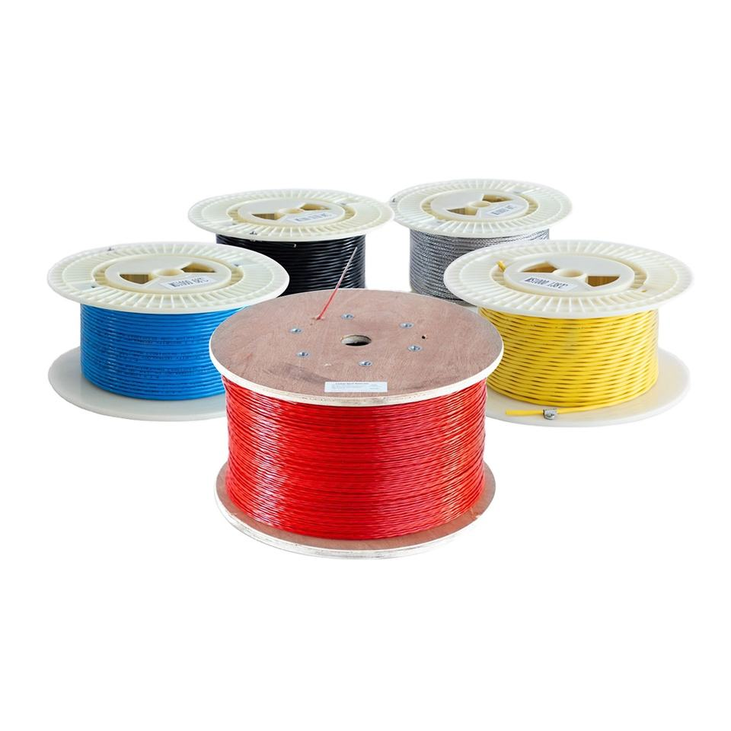
Protection equipment's for suppression system:
Device specification:
Brand: ASENWARE
Price: 6$
Application: Heating
Alarm resistance: 470ohm/1W
Operating temperature range: 170℃
Link: https://www.alibaba.com/product-detail/Asenware-Linear-Heat-Detection-Cable-for_1600375414695.html

Slide 20
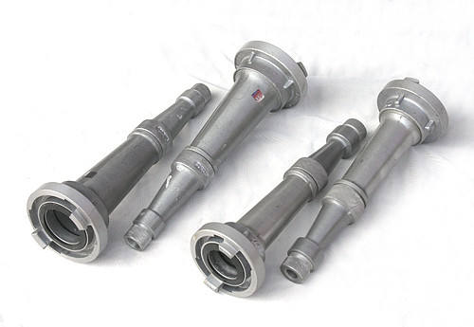
Protection equipment's for suppression system:
Device specification:
Brand: SILVERGATE
Price: 2.3$
Size: 2.5”
Color: Gray
Link: https://www.alibaba.com/product-detail/professional-product-fire-extinguisher-nozzle-high_1700005808433.html?spm=a2700.7724857.0.0.1241216dBSdCgS

Slide 21
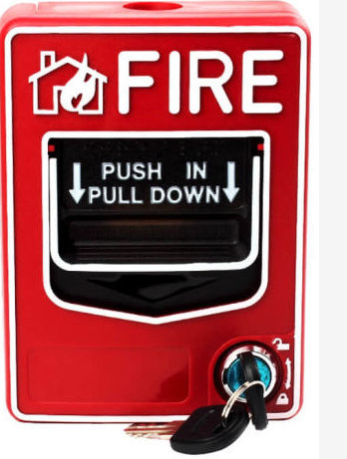
Protection equipment's for suppression system:
Device specification:
Price: 2,300 BDT
Operating voltage range: 9-28VDC Volts
Alarm resistance: 470ohm/1W
Operating temperature range: -10℃~50℃
Link: https://www.indiamart.com/proddetail/6l-class-k-type-fire-extinguisher-20029719730.html

Slide 22
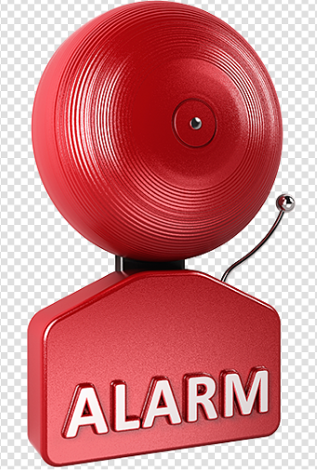
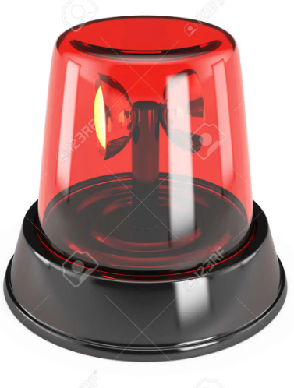
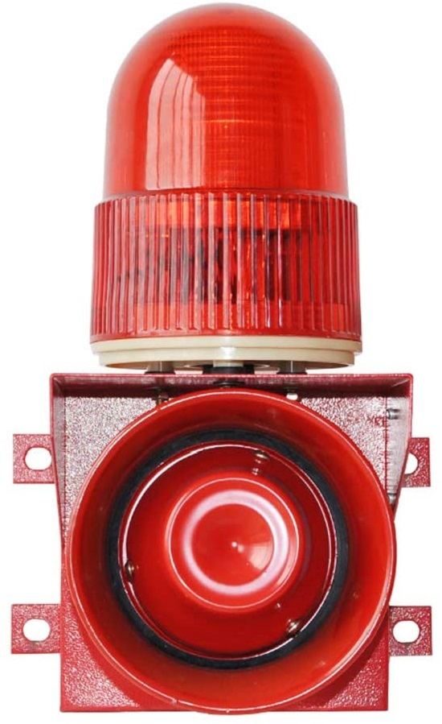
Fire Alarms
Fire alarm (sound only)
Fire alarm (light only)
Fire alarm (light and sound)

Slide 23
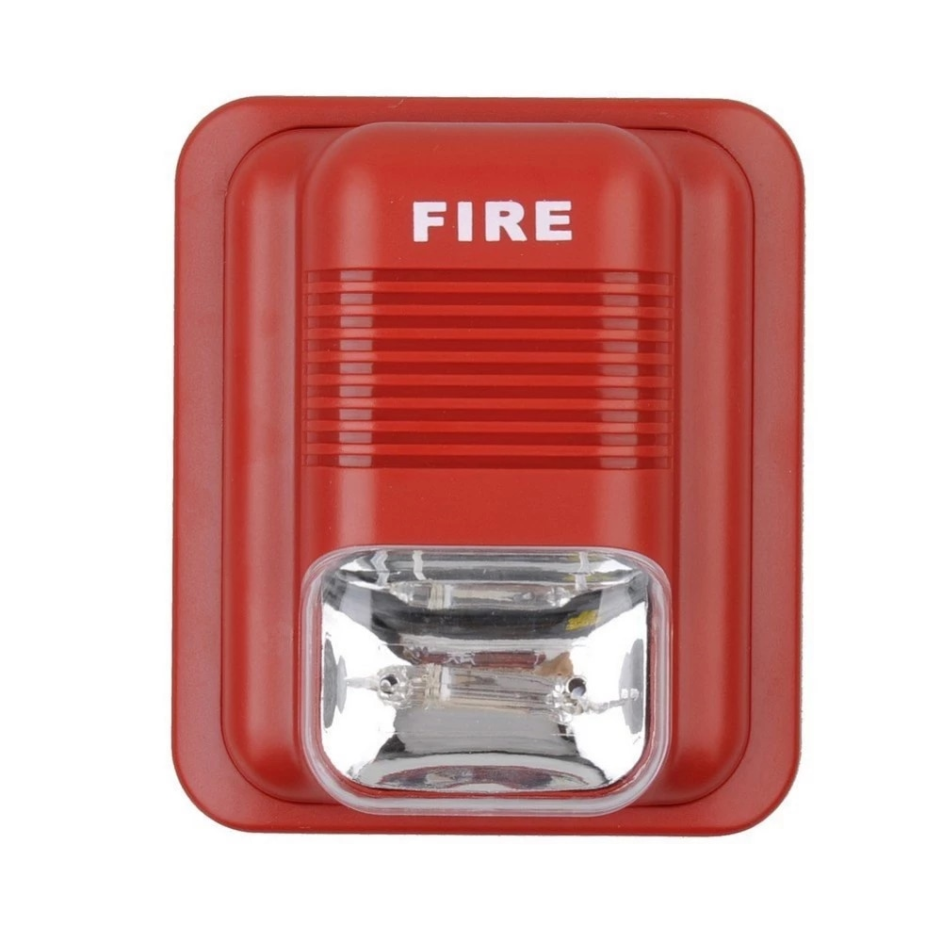
Selection of fire alarm
Device specification:
Brand: Safe Armed
Price: 1,139 BDT
Audio alarm: 100 dB
Flash period: 1.5 sec
Temp range: (10 to 50)°C
Fire alarm with sound and light
Link: https://www.aliexpress.com/item/32502710220.html

Slide 24
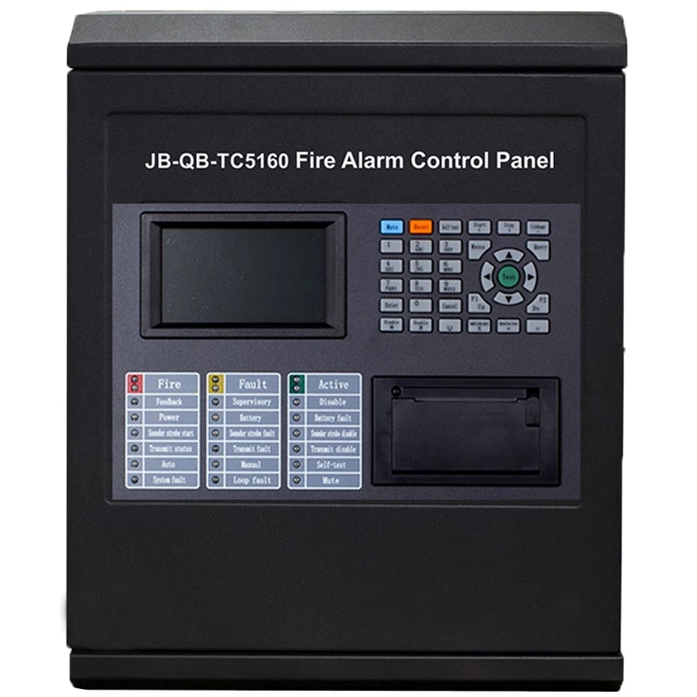
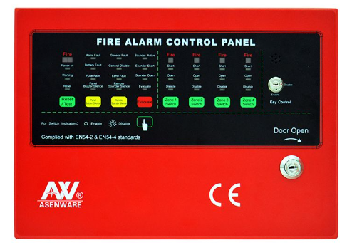
Various types of control panel
Conventional control panel
Addressable control panel

Slide 25
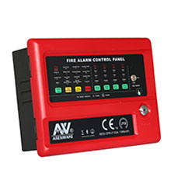
Selection of control panel
Device specification:
Brand: NSE
Price: 19,500 BDT
Zones: 4
Type of control panel: Fire alarm control panel
Link: https://www.bdstall.com/details/fire-alarm-control-panel-49482/

Slide 26
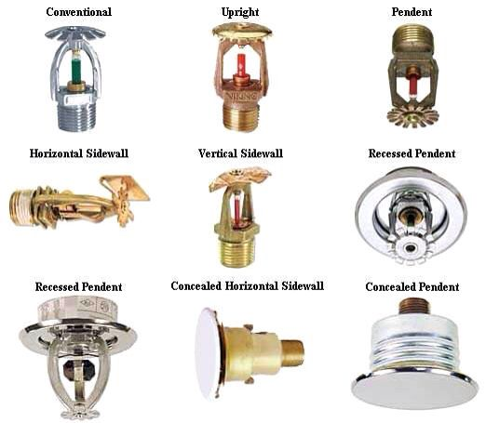
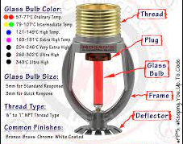
Various types of sprinkler:

Slide 27
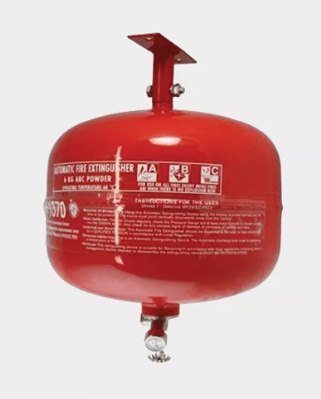
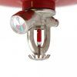
Selection of sprinkler:
Device specification:
Automatic dry powder extinguisher
Price: 3,500 BDT
Operation temp: 68°C
Link: https://www.corporatestationbd.com/product/automatic-dry-powder-fire-extinguisher-bd//

Slide 28
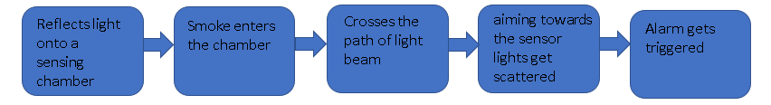
Block diagram of smoke detector

Slide 29
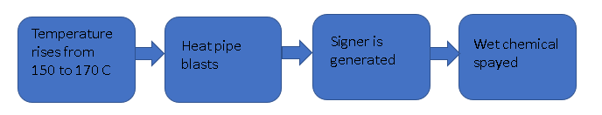
Block diagram of suppression system

Slide 30
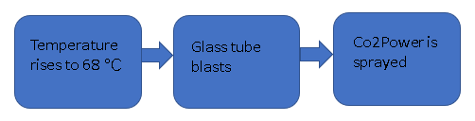
Block diagram of dry powder extinguisher

Slide 31
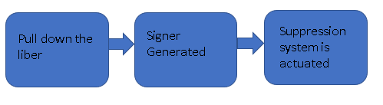
Block diagram of Manual call point

Slide 32
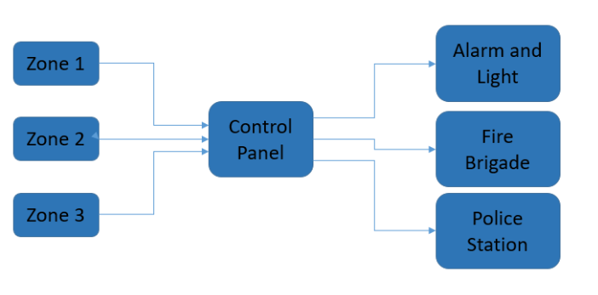
Block diagram of fire detection and control system

Slide 33
Cost Calculation
Equipment | Price in BDT | Quantity | Cost
Smoke Detector | 1,140 | 4 | 4,560
Fire Extinguisher (K Type) | 12,504 | 1 | 12,504
Fire Extinguisher Regular | 2,700 | 4 | 10,800
Heat detection Cable | (6$)570 | 1 | 570
Fire Suppression Nozzle | (2.3$)218 | 3 | 654
Manual Call Device | 2,300 | 2 | 4,600
Alarm System | 1,139 | 1 | 1,139
Control Panel (Conventional) | 19,500 | 1 | 19,500
Automatic Fire Suppression | 3,600 | 1 | 3,600
Total | - | - | 57,927

Slide 34
Thank You

